Slide 1
Data Formats

Slide 2

Introduction
Examples
Real World
Computer
Data
Input device
Data
Dear Mom:
Keyboard
10110010…
Digital camera
10110010…
pp. 59.-61

Slide 3
Format must be appropriate
The internal representation must be appropriate for the type of processing to take place (e.g., text, images, sound)

Slide 4
Examples of Standards
Type of Data | Standards
Alphanumeric | ASCII, EBCDIC, Unicode
Image | JPEG, GIF, PCX, TIFF
Motion picture | MPEG-2, Quick Time
Sound | Sound Blaster, WAV, AU
Outline graphics/fonts | PostScript, TrueType, PDF

Slide 5
Alphanumeric Data
Problem: Distinguishing between the number 123 (one hundred and twenty-three) and the characters “123” (one, two, three)
Four standards for representing letters (alpha) and numbers
BCD – Binary-coded decimal
ASCII – American standard code for information interchange
EBCDIC – Extended binary-coded decimal interchange code
Unicode
pp. 63-69

Slide 6
Standard Alphanumeric Formats
Next 2 slides
BCD
ASCII
EBCDIC
Unicode

Slide 7
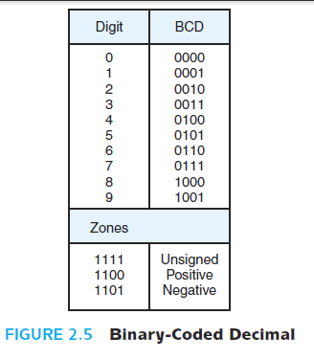
Binary-Coded Decimal (BCD)

Slide 8
Example
7093₁₀ = ? (in BCD)
7 0 9 3
0111 0000 1001 0011

Slide 9
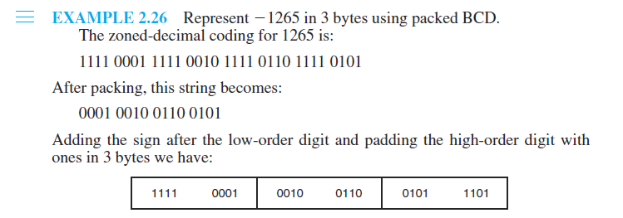

Slide 10
Standard Alphanumeric Formats
BCD
ASCII
EBCDIC
Unicode
Next 22 slides

Slide 11
The Problem
Representing text strings, such as “Hello, world”, in a computer

Slide 12
Codes and Characters
Each character is coded as a byte
Most common coding system is ASCII (Pronounced ass-key)
ASCII = American National Standard Code for Information Interchange
Defined in ANSI document X3.4-1977

Slide 13
ASCII Features
7-bit code
8th bit is unused (or used for a parity bit)
2⁷ = 128 codes
Two general types of codes:
95 are “Graphic” codes (displayable on a console)
33 are “Control” codes (control features of the console or communications channel)

Slide 14
ASCII Chart

Slide 16
Most significant bit
Least significant bit

Slide 17
e.g., ‘a’ = 1100001

Slide 18
95 Graphic codes

Slide 19
33 Control codes

Slide 20
Alphabetic codes

Slide 21
Numeric codes

Slide 22
Punctuation, etc.

Slide 23
“Hello, world” Example
H
e
l
l
o
,
w
o
r
l
d
=
=
=
=
=
=
=
=
=
=
=
=
Binary
01001000
01100101
01101100
01101100
01101111
00101100
00100000
01110111
01100111
01110010
01101100
01100100
=
=
=
=
=
=
=
=
=
=
=
=
Hexadecimal
48
65
6C
6C
6F
2C
20
77
67
72
6C
64
=
=
=
=
=
=
=
=
=
=
=
=
Decimal
72
101
108
108
111
44
32
119
103
114
108
100

Slide 24
Common Control Codes
CR 0D carriage return
LF 0A line feed
HT 09 horizontal tab
DEL 7F delete
NULL 00 null
Hexadecimal code

Slide 26
Terminology
Learn the names of the special symbols
[ ] brackets
{ } braces
( ) parentheses
@ commercial ‘at’ sign
& ampersand
~ tilde

Slide 28
Escape Sequences
Extend the capability of the ASCII code set
For controlling terminals and formatting output
Defined by ANSI in documents X3.41-1974 and X3.64-1977
The escape code is ESC = 1B₁₆
An escape sequence begins with two codes: ESC [
1B₁₆
5B₁₆

Slide 29
Examples
Erase display: ESC [ 2 J
Erase line: ESC [ K

Slide 30
Standard Alphanumeric Formats
BCD
ASCII
EBCDIC
Unicode
Next 2 slides

Slide 31
EBCDIC
Extended BCD Interchange Code (pronounced ebb’-se-dick)
8-bit code
Developed by IBM
Rarely used today
IBM mainframes only

Slide 32
Standard Alphanumeric Formats
BCD
ASCII
EBCDIC
Unicode
Next 2 slides

Slide 33
Unicode
16-bit standard
Developed by a consortia
Intended to supercede older 7- and 8-bit codes
Unicode is a standard that precisely defines a character set as well as a small number of encodings for it. It enables you to handle text in any language efficiently

Slide 34
There were four key original design goals for Unicode:
To create a universal standard that covered all writing systems.
To use an efficient encoding that avoided mechanisms such as code page switching, shift-sequences and special states.
To use a uniform encoding width in which each character was encoded as a 16-bit value.
To create an unambiguous encoding in which any given 16-bit value always represented the same character regardless of where it occurred in the data.

Slide 35
The Unicode Consortium
The Unicode Consortium is a not-for-profit organization that exists to develop and promote the Unicode Standard. Anyone can be a member of the consortium, though there are different types of memberships

